Slide 1
Notes:
I appreciate you guys giving me your time to talk to you about Jupiter Pointe and how we’re working to revive American Dream
So let’s talk a little bit more about why Jupiter Pointe exists and what we’re doing

Slide 2
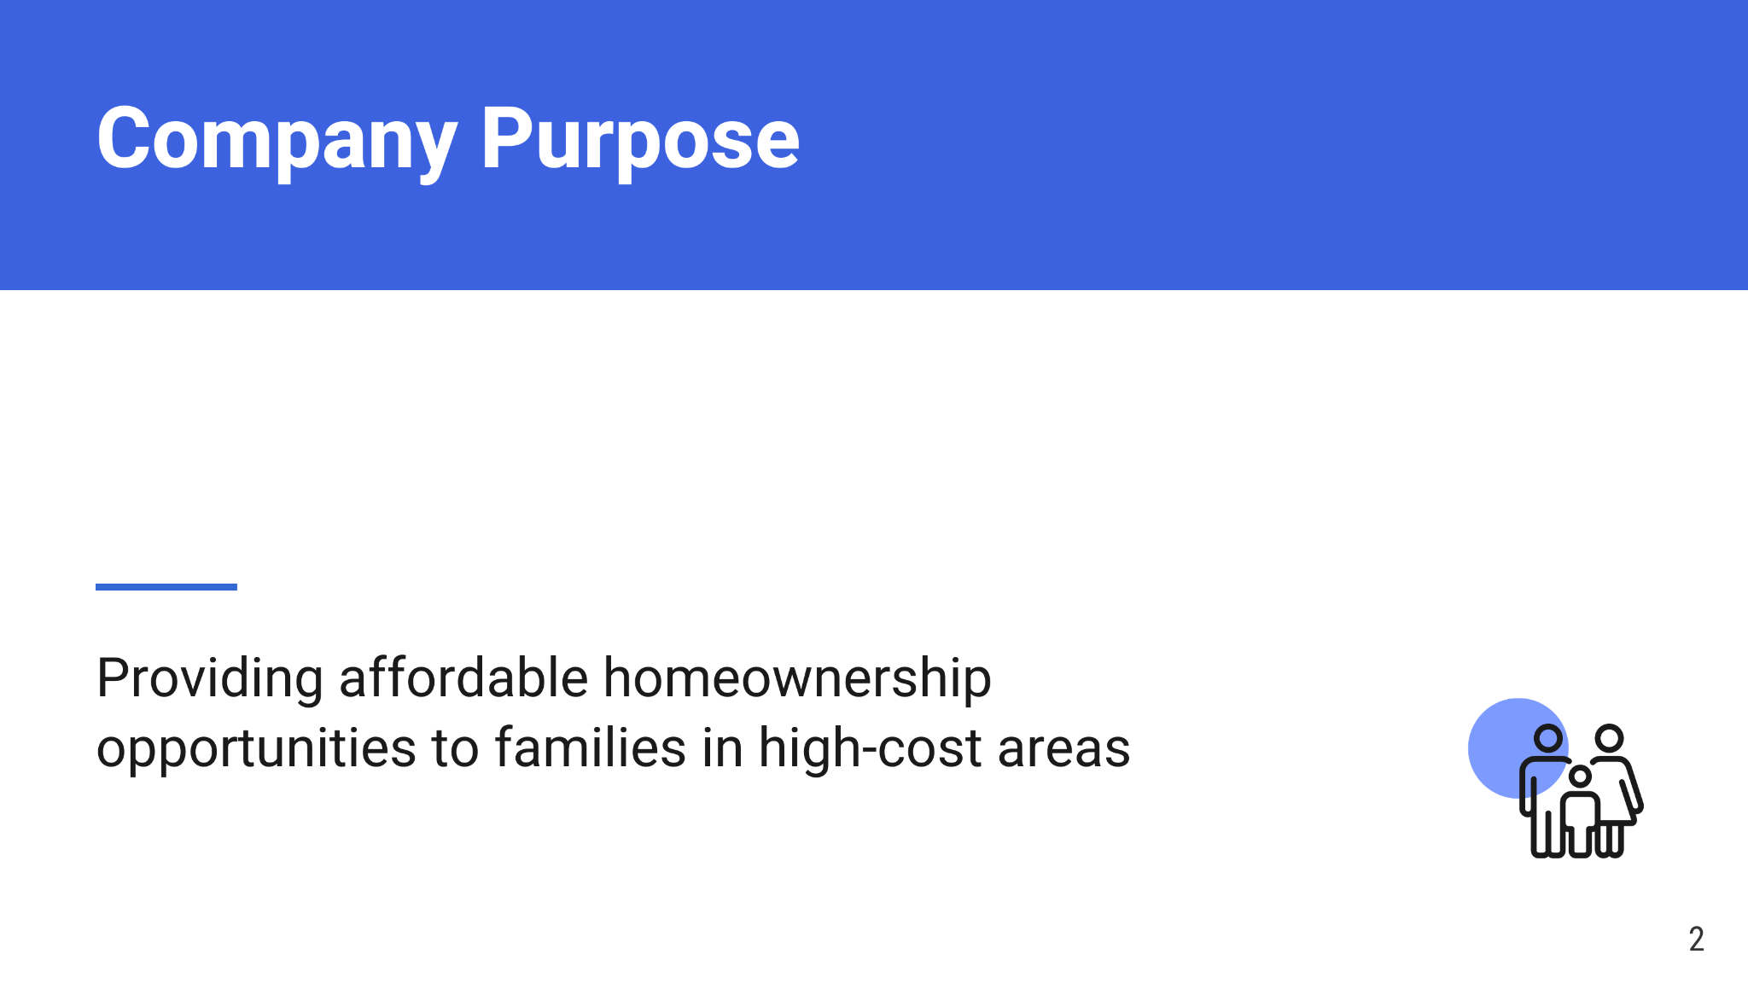
Notes:
A lot of people, myself included, grew up thinking we would get a job, have a family and own a home - something that provides stability both physically and financially
Unfortunately, for many people, especially in densely populated areas like LA, that’s not possible anymore
And our guiding light, if you will, is to address the problems that have made homeownership so hard to achieve, so what exactly do we need to solve for?

Slide 3
Notes:
Well, there are a lot of issues…
But simply put, there’s too much demand and not enough supply
When we go a little deeper, we see that much of the available supply that isn’t as expensive is often dilapidated and really difficult to deal with which effectively makes the housing shortage worse
Most importantly, the truly affordable housing out there, which are often government-subsidized and take years to come to market, are rentals, temporary shelters that don’t focus on a family-friendly environment or on ownership
SO THAT’S WHERE WE COME IN…

Slide 4
Notes:
We’re providing that ownership! With years of experience in real estate development and affordable housing, we’ve seen these issues first-hand and know how important home ownership can be to families and building wealth
We’ve assembled a really strong team, developed processes to get projects done quickly and efficiently, and because this issue isn’t going to fix itself, our team has started to go out and do the work to prove our concept, and actually get people in houses
And speaking of our team, let me introduce you to them

Slide 5
Notes:
You know me, I spent the beginning of my career with a National affordable housing developer where I managed the acquisitions and construction management for all of our deals
My father, Milton, has been building and managing homes for the last 30 years and bring invaluable experience to the management team
Ricardo is a builder at heart and makes sure our projects start and finish on time, and provides great quality control top ensure our buyers get incredible homes
Stacey is the liaison between us, our buyers and their agents, and over the last 25 years has not only sold a lot of homes, but has developed an incredible ability to simplify the buying process and help people understand homebuying and homeownership, which has been so important with many of our buyers being first-time homeowners
The of course, everyone’s favorite, our lawyer. I didn’t think I’d ever meet anyone like this, but Matt genuinely loves the law, and because of that he keeps us up to date with both the applicable codes, ordinances, etc.., and what’s coming down the pike so we’re consistently prepared for the changing landscape of the future - he helps us get deals done!
Now let’s take a look at some of what we’ve done

Slide 6
Notes:
So we have the goal and we have the team, but needed to make it work in the real world
This is just one of our projects, but we think it does a good job of illustrating the transformation of a unlivable building into a home that we sold at an affordable price and still profited from, and we brought it to market quickly and efficiently, then then we did it a couple more times to make sure it wasn’t a fluke, and those worked out the same way, we provided affordable homes to families and made a profit
Now with the amount of housing we think is needed, this is just a drop in the bucket, if that, right? But to understand how far we can go, we need to understand the numbers behind the need. How far behind is housing supply?

Slide 7
Notes:
Well, at least in our initial market, turns out it’s very behind
LA’s on track to deliver about ⅓ of the homes it needs to by the end of the decade, so the market is large
But with a market this large, even though we have opportunity, we have to be prepared to go against hurdles and other solutions in the space

Slide 8
Notes:
So What exactly are we up against, well quite a lot actually, groups with tons of money, profit-motivated flippers, and even the government and they all do something well…..
But from big developers and the government, down to the smallest mom and pop home flippers, nobody addresses to key issue: helping people own their home and build legacy
And here’s what sets us apart, but how do we actually get there?

Slide 9
Notes:
Well, we touched on this at the beginning, but we’ve developed a process that gives us some advantages
Most importantly, our team has the experience and knowledge to comfortably purchase properties that others shy away from. We pair that with a streamlined construction model to provide homes at affordable prices
And because we’re in this for the long haul and intend to grow so we can provide these opportunities to as many families as possible, we also educate our buyers along the way to make sure once they own the house they keep it
And speaking of the long haul, let’s talk about growth and the future

Slide 10
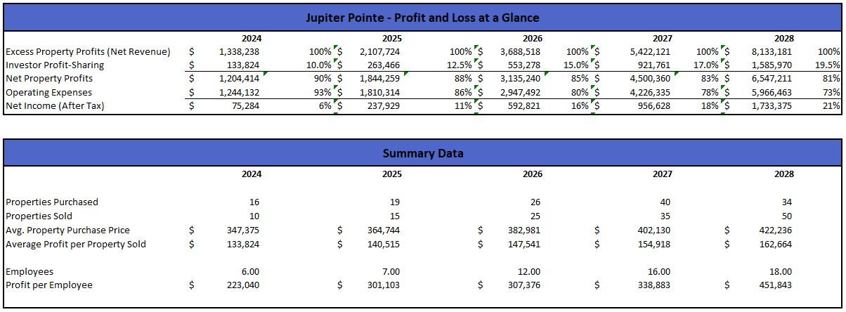
Notes:
So with our team as it stands, we’ve gone through the numbers and we have the capacity to sell about 20 projects, similar to the one I showed you earlier, per year
But because our goal is controlled growth, we’re conservatively planning to complete 10 deals next year, and gradually ramp up efforts to go from 10-50 over the next 5 years
It’s because we’ve done this before that we understand growing sustainably rather than fast is what’s going to enable us the ability to provide affordable homes to families over the long term and we’re ready to do that, SO…..

Slide 11
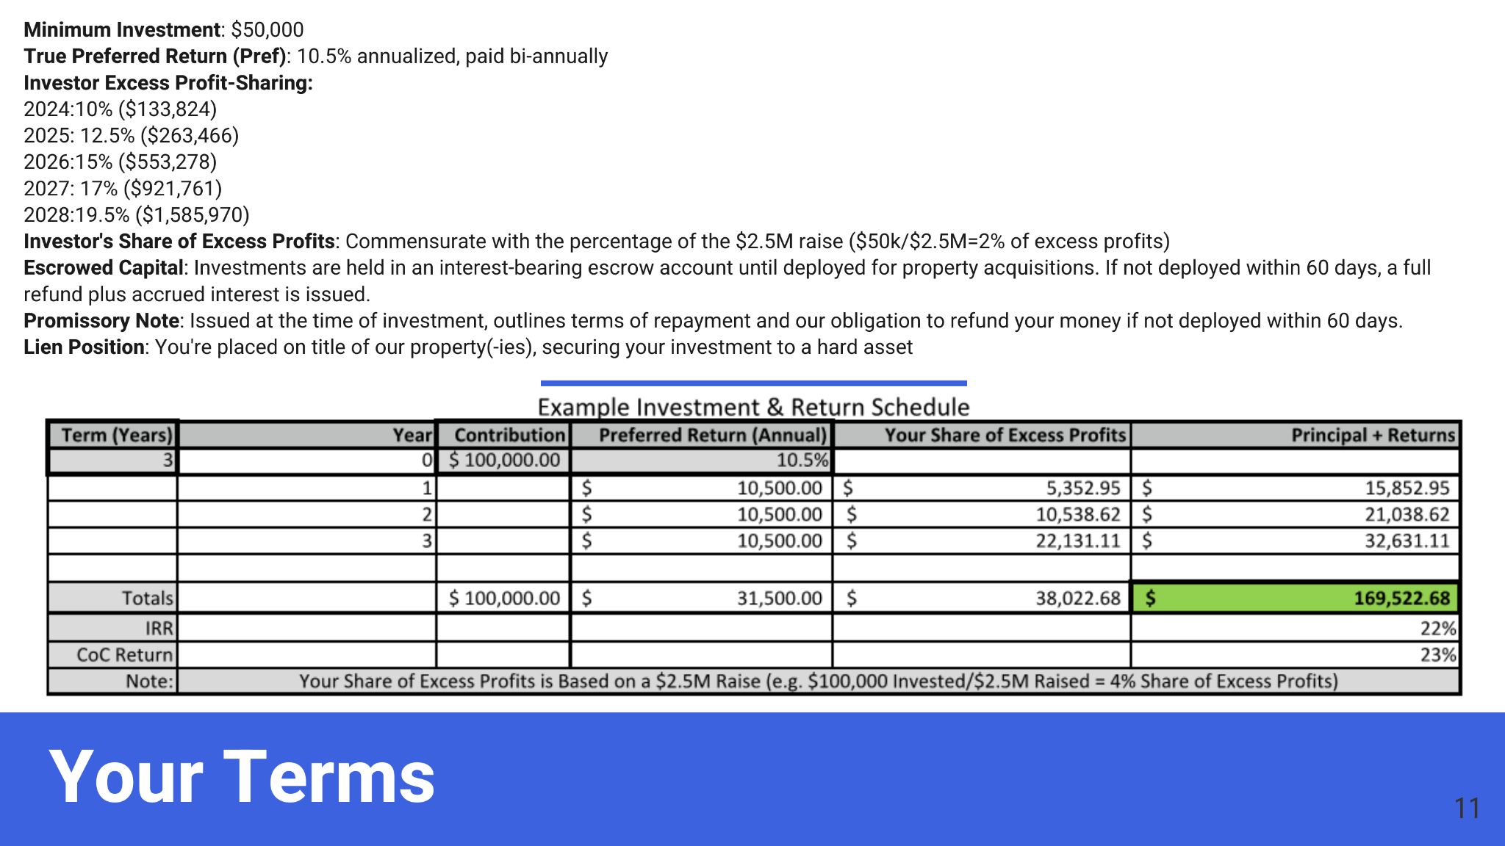
Notes:
Our mission is clear, our concept is proven, and our team is ready, but we need your help, so let’s talk about where you come in….
Min $50k, 10.5% regardless, and profit sharing
We take the stewardship of your money very seriously and have a great game plan to grow your investment while helping a lot of people, but to ensure your protection, when you invest, you’re on title of our properties, so your investment is secured by a hard asset
Let’s look at an example to give you an idea how your money will grow…
In short, you entrust us with $100k for 3 years, and we give back $170; leave that same $100 with us for 5 and we’re giving back more than $290k!
We’re in this for the long haul, so the longer you entrust us with your money and help us impact people’s lives, the more of the profits you get back
Really, in the end, your money is doing something good and at the same time, you're getting great return

Slide 12
Notes:
In summary, our goal is provide affordable homeownership, and with a really strong team who has a deep understanding of how to turn troubled properties in profitable, but attainable homes, we hope, with your help, to grow and impact families all across the country. Our goal is affordable home ownership, but our mission is to bring back the American Dream and help families grow and leave lasting legacies in the places they call home
Thank you for taking some time to learn about Jupiter Pointe and I’ll now open it up to any questions you might have

