Slide 1
ADOR
RISE IN LOVE
INDIA'S FIRST HOLISTIC RELATIONSHIP AND GROWTH PLATFORM

Slide 2
MISSION
TO TOUCH 10 MILLION LIVES IN THE DOMAIN OF
RELATIONSHIP
BY
ENABLING
CONNECTIONS, EDUCATION AND EXPERIENCES

Slide 3
PROBLEM: NO ONE-STOP PLATFORM FOR INDIVIDUALS TO ACCESS HOLISTIC EXPERIENCE AROUND SERIOUS RELATIONSHIPS, INTERESTS AND GROWTH
NO ONE STOP PLATFORM FOR SEARCH, COACHING, EDUCATION AND MATCHMAKING FOR SERIOUS RELATIONSHIPS
FOMO DRIVEN CONNECTIONS’ EXPERIENCE,
ONLY TOP 10% MALE RECEIVE ENGAGEMENT SIMILAR TO 75% FEMALES
LACK OF RELEVANT POSITIONING AROUND RELATIONSHIP AND GROWTH

Slide 4
SOLUTION: ALL THINGS AROUND SERIOUS RELATIONSHIP BASED ON INTERESTS AND GROWTH MINDSET WITH INCLUSIVITY AND CONFIDENTIALITY
ADOR
MEANINGFUL, INCLUSIVE AND AUTHENTIC MATCHMAKING, EDUCATION, INTERACTION BASED ON INTERESTS AND GROWTH IN AN INCLUSIVE AND CONFIDENTIAL WAY

Slide 5
PRODUCT: ADVANCED RELATIONSHIP TECH PLATFORM ENABLING SEARCH, EDUCATION, INTERACTIVE ACTIVITIES IN A CONFIDENTIAL AND PRIVATE APP
Express: Showcase a holistic profile by including
An Image
A Detailed Description
Proficiency in chosen activities
Explore: Proprietary Algorithm suggests profiles in common or complimentary personality categories
Interactive Activities: Gamified Activities, Quiz, Facts and Poetry
Education: Knowledge with interactive blogs, informative modules

Slide 6
TRACTION: COUNTER-INTUITIVE GROWTH - 5X LIKE TO PASS RATIO WITH 50% M-O-M GROWTH, 43.6% RETENTION AND 2000% IMPROVED CONNECTIONS WITH “APPRECIATE” FEATURE
QUALITY ENGAGEMENT
GROWTH STORY
Ador's Ratio
Industry Standards
Installs
Growth in Sign-Ups: M-O-M
70,000
+50%
Ratio of
Like to Dislike
1:1.1
1:5
>
Matches
4x Improved Results in Top 3 Months
Retention ( WAU/MAU) last month
3x Better than Past Months - Aug to Nov 2022
3:1
43.6 %
Ratio
of
Male to Female
Daily Active Users
Engagement
Growth in Engagement: M-O-M
300,000
+55%
6:1
Monthly Active Users
Growth in MAU ( Last month )
7500
+40%
10:1

Slide 7
MARKET SIZE: MULTI BILLION DOLLAR MARKET WITNESSING CONTINUOUS GROWTH WITH INCREASED ENCOURAGEMENT FROM MACRO ECONOMIC DRIVERS
GLOBAL RELATIONSHIP-TECH MARKET SIZE: USD 10 Billion by 2027 at CAGR of 7%
TAM
SAM
SOM
USD
6.09 Billion
USD
3.5 Billion
USD
125 Million
Total Available Market
Serviceable Available Market
Serviceable Obtainable Market
Global Market Size
Global Market
Size based on Interests and Passions
Online Market Size based on Interests in India and USA
India is a Young Nation: More than 50% of Indian Population is below 28 years of Age

Slide 8
GO TO MARKET: OPTIMIZED PERFORMANCE MARKETING CAMPAIGNS ALONGWITH CONVERSATION CHANNEL HOSTED BY MS INDIA, MISS ASIA INDIA, 80+ LEADERS
Ador
Conversation
80+ Leaders like
World Record Holders,
Miss Asia India,
Mr Icon India
sharing their story showcasing - Interests are at the core of Growth and Relationships
Ragini Mahraj
Grand Daughter
of Pt Birju Maharaj
Miss Trans Global 2021
World Record Holder in Kathak
Rohini Mathur
Mrs India,
Fashion Influencer
Praashekh Sarod
Sarod Player and Musician
Sayani Chakroborty
Bharatnatyam Dancer
Sarina Pani
IFBBPRO, Beach Body
Female 2021
Performance
Marketing
CAC less than industry standards
Google Adwords
Snapchat Ads
Ads on Meta Platform

Slide 9
DIFFERENTIATOR: ONLY PERSONALITY, PASSION AND INTEREST BASED MATCHMAKING APP WITH GEN AI, AI/ML BASED CONFIDENTIALITY AND MODERATION FEATURES
Only love-tech app where individuals can express and explore based on multiple interests
Confidentiality of individuals and conversations - chat encryption and no screenshots
MVP Stage
GENERATIVE AI based Integration
for
Experience Enhancement
2 Industry First Innovations, 2 copyrights, Brand Registered
Holistic Relationship Tech enabling content, search, interactive activities

Slide 10
DIFFERENTIATOR: ASPIRATIONAL BRAND WITH 5X IMPROVED CONNECTIONS PROPELLED WITH RECOMMENDATION TECH AND INDUSTRY FIRST FEATURES
5x Improved connections with recommendation tech - 50% males receive engagement compared to 50% females
Holistic Relationship Tech enabling content, search, interactive activities
2 Industry First Innovations, 2 copyrights, Brand Ador Registered
Advanced and aspirational brand with message “Interests at the core of Growth and Relationships”

Slide 11
IMPLEMENTATION OF SUSTAINABLE DEVELOPMENT GOALS (SDGS) IN ADOR - ENABLING INDIVIDUALS TO EXPRESS AND CONNECT BASED ON THEIR IMPACT QUOTIENT
Unique Features
Development
Individuals can showcase
their SDG Goal on profile
Cause that appeals them the most
Preference to connect with like
minded individuals
Having conversations around causes
with common appeal
Roadmap for development of SDG
Phase 1: Rolling out integration for SDG Goal based expression and connection on Ador
Phase 2: Actively instigating algorithm to connect individuals based on their SDG Impact preference
Phase 3: Enabling gateways for enabling conversations and other activities based on SDG goals
Priority SDGs
Major User Personas
Persona 1: Individuals who are above 20+ years in age enrolled in educational courses or pursuing education
Persona 2: Individuals who are emotionally driven for a cause
Persona 3: Recently employed individuals with disposable income
Roadmap for impact driven distribution
Phase 1: Individuals can express and connect based on SDG goals
Phase 2: Individuals can have conversations around similar topics
Phase 3: Individulas get gate-way to donate or create campaigns around similar causes
Customers
Distribution

Slide 12
INDIRECT COMPETITION: INDIRECT COMPETITION IN THE “CONNECTIONS AND SEARCH” ASPECT. NO DIRECT COMPETITOR SERVING ALL ASPECTS OF RELATIONSHIP TECH
INTEREST AND PERSONALITY BASED
HOLISTIC
RELATIONSHIP TECH

Slide 13
BUSINESS MODEL: DRIVING TOP-LINE REVENUE POWERED WITH 5+ MODELS ACROSS SUBSCRIPTIONS, ADS, ONLINE EVENTS, UNIVERSITY AND DIGITAL GIFTING
1
2
3
4
5
In-app Purchases
Ads- Network
Online Events
University
Digital Gifting
CLUB MEMBERSHIPS
PRESTIGE CLUB
9 BENEFITS - INR 799 per month
PRIME CLUB
6 BENEFITS - INR 499 per month
PROFILE BOOST STICKERS - INR 399 per month
ADOR PACKS - INR 199 per month
SELF HOSTED ADS NETWORK TO PROVIDE
CONTEXTUAL,
SELF-ENGAGING
RELEVANT ENGAGEMENT
SIMILAR TO BILLION DOLLAR SOCIAL MEDIA COMPANIES- Pricing will be based on engagement
Online Paid Interest or Passion Based Networking Events hosted by Leader: INR 399 - INR 999 per month
Example - Dancing Karaoke, Stand Up Comedy, Music Jams, etc.
Online Courses around Relationship - Courses : INR 499 to INR 2999 per course
Includes Freemium type of offering with courses ranging from intermediate to advanced level curriculum
Gateway to provide Paid Digital Gifts to the profiles of preference.
Paid Digital Gifts provide access to multiple options for connecting with the other profile
Pricing range from INR 19 to INR 999 per month

Slide 14
TEAM: EXTENSIVE EXPERIENCE IN TECH, BUSINESS AND PRODUCT POWERED WITH
advisory having innovative experience of forging VENTURES
CORE
INVESTOR and MENTOR
UDIT SHAH
VISHAL RAO
Cofounder - Product
MBA - IIFT ( Top 10 Indian B-schools )
Ex- MSIL
Ex- Consultant
Investor
Family Office of Vishal Rao and Sons
Sector Agnostic Investor and Mentor
Tech Expert
and
coined as "GOAT"
+10
TEAM
MEMBERS IN
5 DOMAINS
Please Note: Ador has engaged with 5+ Mentors / Advisors. Individuals who have engaged since a long time or having position in the cap table are presented on the deck
Company is Startup India under DPIIT
Go Global World Cohort Startup

Slide 15
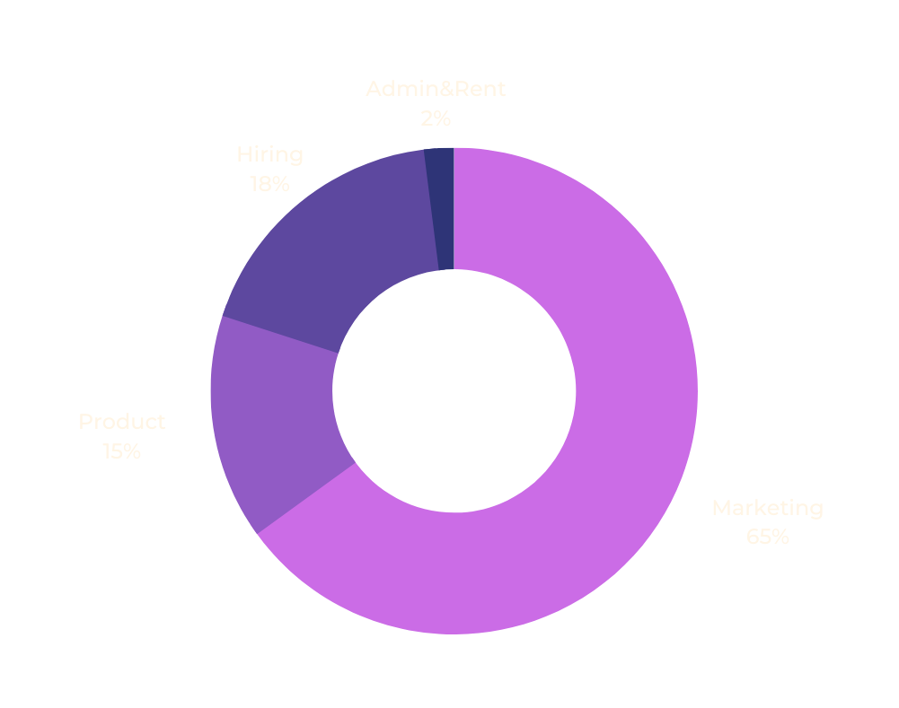
FUNDRAISE ASK: TO POWER ALL FIVE BUSINESS MODELS FOR HITTING TOPLINE REVENUE MILESTONES
MILESTONES
2.8 million installs in
top 20 cities
1
2
To achieve MRR of $30,000 and ARR of $400,000
$1.0 M
3
To reach MAU of 120,000 and DAU of 7,500
TIMELINE: 24 Months

Slide 16
CONTACT US
udit@adormatch.com
+91-9909945118
www.adormatch.com
adormatch
linkedin.com/company/adormatch

