Slide 1
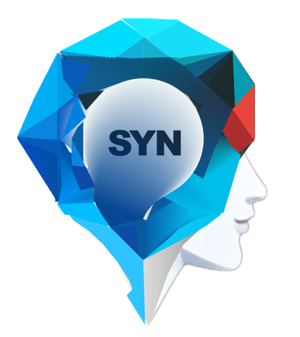
Synapse
The New AI Sales Process for SMBs
Since 2023
Confidential

Slide 2
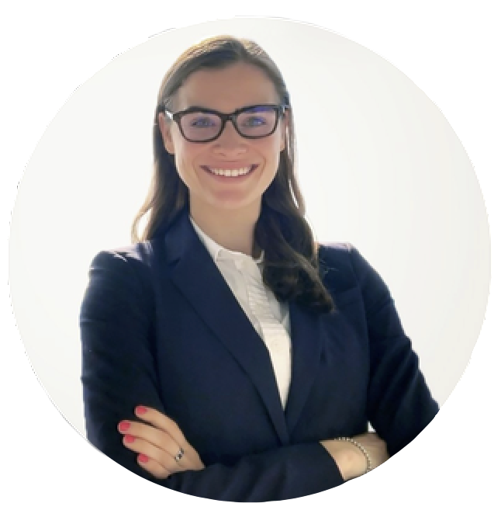
Leadership
SYNAPSE
Saad Bin Shafiq
Founder/CEO
Aamir Shehzad
CTO
Mickala Olesen
Advisor
Expertise: Growth hacking, 8+ years in Business Dev.
Revenue Impact: Helped generate $22M+ for clients..
Key Companies Helped: Nerdwallet, Clickvoyant (Techstars '22), Brand Da.
Help Scale Startups
Milestones: $0-$2M ARR for Brand Da in 14 months.
Education: Bachelor's in Comp Sci & Math, Hunter College, NY.
Expertise: 16+ years in software development, owns software house.
Solutions: CMS, DBMS, billing systems.
Innovation: Specialized apps and platforms.
Global Clients: US, Europe, UAE.
Notable Role: ex VP of MTBC, now Carecloud (publicly traded).
Notes:
team members

Slide 3
The Problem: Outdated Sales Cycle
High Costs: SMBs spend up to $750k/year for 15-30 weekly qualified meetings.
Time Drain: SDRs use avg 70% of time on prospecting, only 30% on customer talks.
Low Engagement: Industry email reply rates are 1-3% for outbound, max 8% overall on 1000 outbound emails.

Slide 4
Current Solution Example:
Team: Arc (Series A) has 2 SDRs and 1 Marketing manager which costs approx $420,000/year.
Time: 70+ hours/week on prospecting and market research.
Results: 5-7 qualified meetings/week, 1% email reply rate on 1000 outbound emails.

Slide 5
The Synapse Solution
Let AI automate your sales and prospecting process
Tell the AI who your target customers are
Let the AI go to work, and do prospecting for you
Automatically generate thousands of hyper-personalized cold outreaches
Transform these outreaches into warm leads
Watch the warm leads become meetings for you sales team
Get pre-meeting and on call recommendations from the AI for maximum efficiency
Confidential

Slide 6
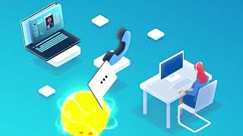
Future of Sales Cycle with Synapse
Synapse Sales Cycle Explainer Video (55 seconds): https://youtu.be/YOTajnYx1fM
Confidential

Slide 7
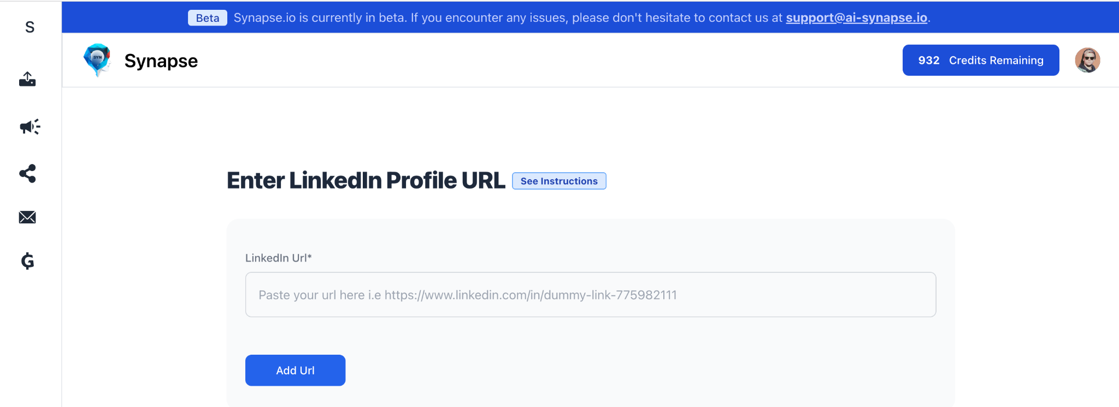
With AI Synapse
Cut Costs: OpEx save: $250K/yr - $2M/yr
Save Time: Manual process time save 70 - 1000+ hours/week
Streamline Sales: Automates your entire sales funnel
Personalize Outreach: Hyper-personalized communication
Enhance Meetings: Pre-meeting notes and on-call body language readability
Confidential

Slide 8
Current Traction
Within 24 hours of our soft launch, 100 senior leadership and salespeople signed up, out of 221 website visitors. (Sep 24)
Promoted the tool subtly, mentioning it in the "P.S." section of another post shared on LinkedIn and Twitter (X).
Free Sign up today to experience our MVP at www.ai-synapse.io

Slide 9
Market Leading Full Suite Offerings
SYNAPSE
Features/CRM
Hyper-Personalized Outreach | ✓ | ❌ | ✓ | ✓
AI-Powered Calling & Texting | ✓ | ✓ | ❌ | ❌
AI-Generated Voice Notes for LinkedIn & X | ✓ | ❌ | ❌ | ❌
Real-Time AI Recommendations During Calls | ✓ | ✓ | ❌ | ❌
AI-Powered Marketing Strategy Recommendations | ✓ | ❌ | ❌ | ❌
AI-Powered Personal Assistant | ✓ | ❌ | ❌ | ❌
AI Powered full Demand gen funnel | ✓ | ❌ | ❌ | ❌
Confidential

Slide 10
Synapse: Seizing the $265B Opportunity
Initial Focus on SMBs in SaaS and Marketing Industry
Headcount: Less than 500 employees
Tech Stack: Utilizing platforms like Gong, Lemlist, Instantly, Salesloft, Outreach, etc.
Region: North America
Annual Revenue: Typically below $50M
Growth Stage: Seed to Series C funded companies
Decision Makers: Targeting Founders, CMOs, Sales Directors, and Heads of Business Development
Pain Points: Struggling with long sales cycles, low email reply rates, and inefficient prospecting

Slide 11
Tiered Pricing
Comparison:
Ample Market: $505/month
Gong: $516/month
Lemlist $241/month
Instantly: $274/month
Starter
Pro
$200/user/mo
$350/user/mo
800 Outbound Messages
Email Support
2000 Outbound Messages
Chat Support/Email Support

Slide 12
Investment & Milestones
Capital Raise: $1.7 M Post Money SAFE
Use of Funds:
Salary of Talent: Hiring key roles in engineering, sales, and customer success
AI Training/R&D: Enhancing machine learning algorithms and data models
Data: Acquiring and maintaining quality data sets
Marketing: Customer acquisition and brand building
Milestones:
Launch: By December 2023
User Growth:
Reach 3,000 users by April 2024
Scale to 10,000 users by December 2024
Confidential
Notes:
how to get those users

Slide 13
Book a meeting: https://calendly.com/ai-synapse
Saad Bin Shafiq,
CEO/Founder AI Synapse
Free Sign up page for our MVP: https://www.ai-synapse.io
saad@ai-synapse.io
LinkedIn | Twitter (X)

