Slide 6
Supported By A Conducive Environment, Harboring Rapid Adoption Of Internet And Technology
India has a scale digital community, with nearly 640 million Internet users and 550 million smartphone users spending 1.3 trillion hours online

Slide 11
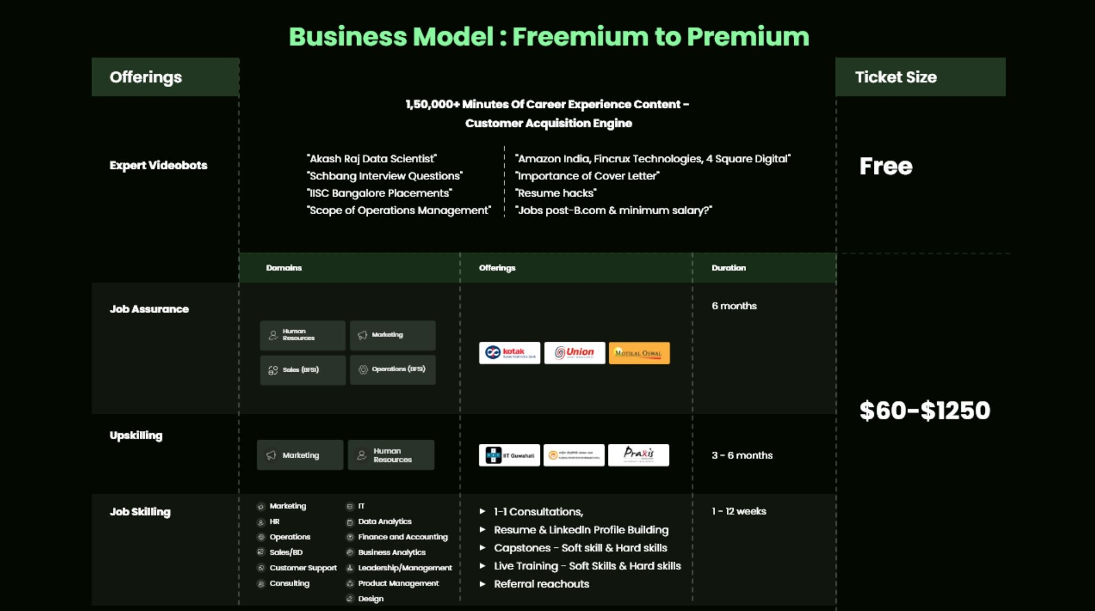

Slide 12
