Slide 1
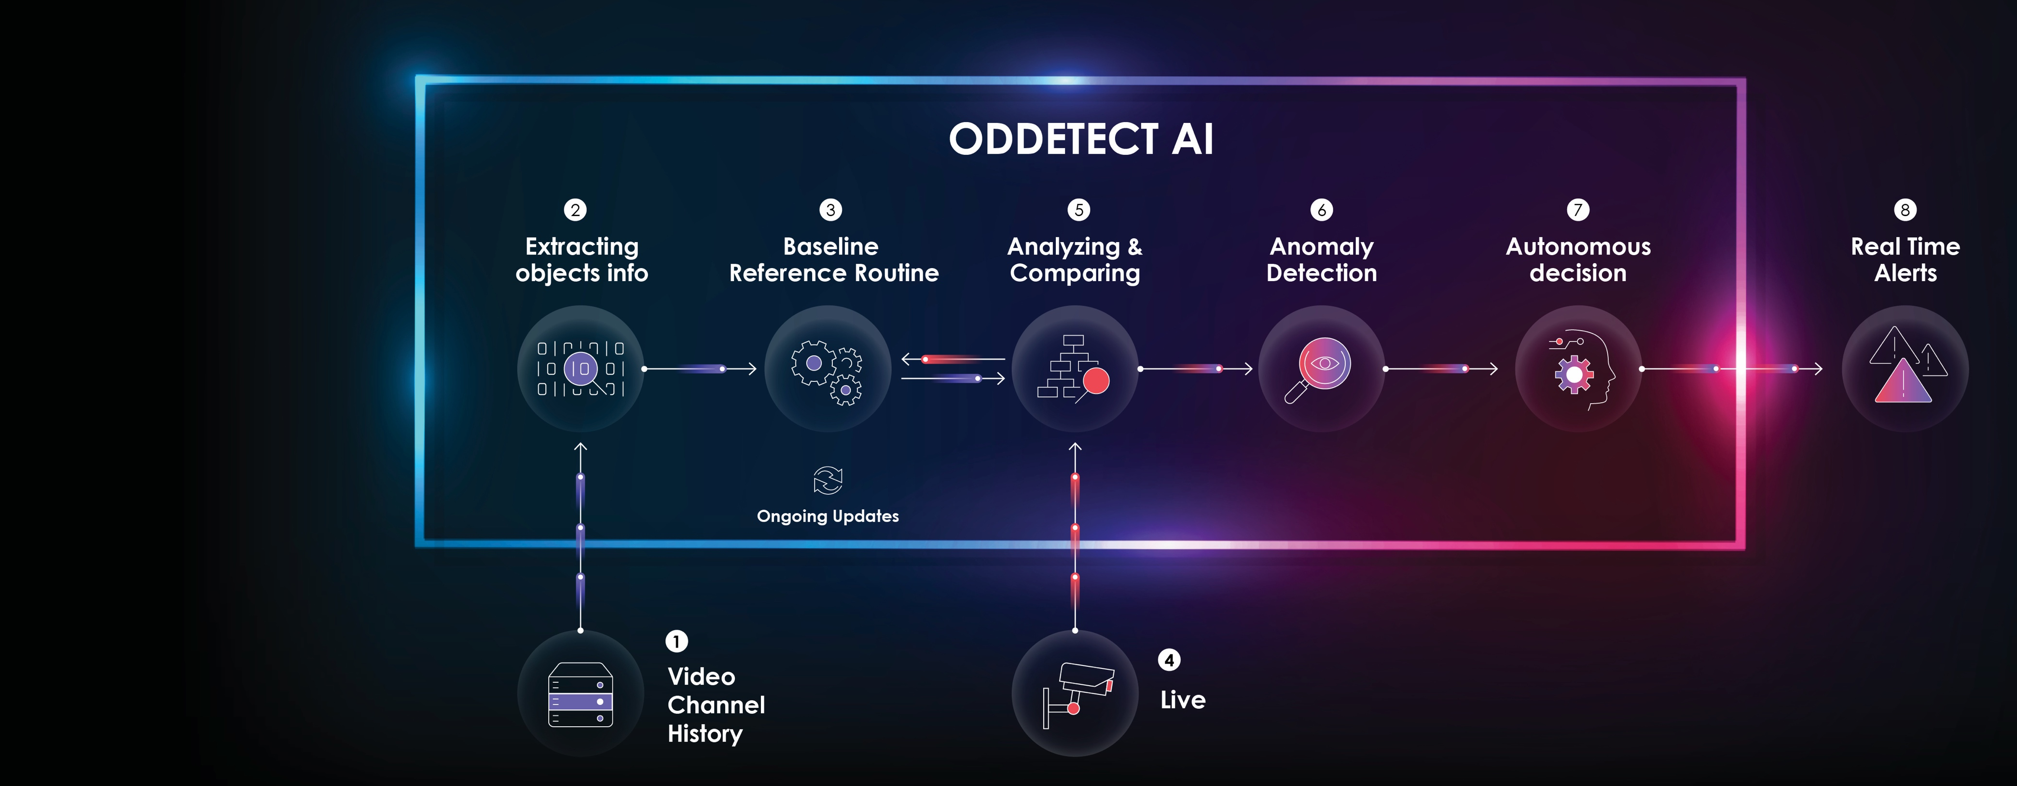
REAL TIME VIDEO MONITORING
A Unique Anomaly Detection Video Analytics Solution For Public Space
THE NEED
There are hundreds of millions of public video surveillance cameras around the world connected to control rooms. Organizations are investing billions hoping to gain real time knowledge for real time decisions and to prevent incidents.
Video systems produce huge amounts of data that is typically only stored for possible later forensic use. Less than 1% of this video is viewed in real time. Thus, the main purpose of their investment is missed.
Human monitoring of multiple video cameras is totally ineffective. Existing video analytics solutions for real time monitoring / alerts do not meet end clients’ needs. There is a great need for AI powered video monitoring.
THE OPPORTUNITY
Tens of thousands of end clients are looking for solutions to help them effectively monitor video in real time. Video equipment manufacturers also acknowledge that they must have a solution for AI real time analytics.
It’s a huge market opportunity for Oddetect’s technology. The video analytics market was valued at $2.4B for 2021 and expected to grow to $5.9B in 2026.
ODDETECT’S UNIQUE APPROACH
All incidents of interest contain abnormalities (e.g fights, vandalism, burglaries, fires, smoke, traffic incidents and many others).
Oddetect’s platform identifies abnormalities, unusual events and suspicious behaviors and send alerts in real time by leveraging an automatic & autonomous process. It’s the only way to meet the challenges of real-time monitoring.
THE SOLUTION
Leveraging innovative & propriety unsupervised machine learning technologies, Oddetect imitates the way the human brain identifies visual anomalies.
First Oddetect automatically analyses historical video, creating a baseline reference routine of what is “normal.” The system then compares the live feed from cameras to the baseline, autonomously determining what is anomalous. Once an incident of interest is identified, alerts are sent in real time to the control center personnel allowing them to respond to events in real time.
The system is able to simultaneously analyze thousands of cameras allowing it to be effective for multiple use cases for cities, critical infrastructure, transportation, traffic control and many others.
COMPANY OVERVIEW
Industry: Surveillance video analytics
Employees: 9
INVESTORS
The Israeli Innovation Authority, private investors and investment funds
FINANCIAL INFORMATION
Stage: Seed 4 / Pre round A
Funding to date: US $4.2M
Monthly burn rate: US $125K
FINANCING REQUIREMENTS
$1.5M
USE OF PROCEEDS
Secure multiple sales deals with leading end clients
Develop edge/camera anomaly detection analytics
Secure an OEM agreement with a leading camera manufacturer
THE EXECUTIVE TEAM
Gil Kiriaty, Founder & CEO
Formerly the CEO & founder of a number of global security and loss prevention firms, Gil holds more than 20 years of executive leadership experience and deep domain expertise.
Levitz Ofen, VP R&D
An innovator, researcher and R&D manager, Levitz has more than 12 years’ experience managing R&D teams, AI, Deep Learning and image processing. He holds an MA degree in CS and he is a Major in the Intelligence Corps (reserve duty)
Prof. Michael Werman, Chief Scientific Officer
A global expert in image processing, geometry and graphics, Prof. Werman is an accomplished thought leader with more than 100 academic publications.
Jonathan Ben-dov, VP Sales & Marketing
A senior business developer, Jonathan brings over 25 years of experience in software markets & international business development, specializing in HLS.
SYSTEM FLOWCHART
GO TO MARKET
Targeting the B2B market via systems integrators and, in some cases, directly with end users.
Oddetect has established a significant network of contacts and re-sellers in LATAM, the EU and APAC including Elbit, Mer, Thales, NEC, Mitie, TotalPlay, Telmex amongst others as well as a number of end users. Together we are targeting smart cities, industrial, commercial, and transportation facilities, with several projects in the approval stage. We have also started a testing process with camera manufactures for a camera imbedded solution via OEM.
REVENUE MODEL
1st stage: perpetual license + technical support.
2nd stage: software as a service (as recurring revenue)
OEM agreement with cameras manufacturers (testing starting with Canon & Hanwha)
RECENT MILESTONES
A deployment at the command & control center of the municipality of Jerusalem.
CONTACT
Gil Kiriaty, CEO Gil@oddetect.com +972 (0)54-624-0096
www.oddetect.com

