Slide 1
A US entity, looking for €500k funding to address a Global TAM of $1.5Tr
SYMPLUM
Insurance Claims Self-Service Marketplace on your mobile, secured by Blockchain​
Symplum Technologies Holding LLC (Delaware) Esteban Ribot Founder & CEO
esteban.ribot@symplum.com
+34 616 647 790 (WhatsApp)
https://calendly.com/esteban-ribot-reuniones

Slide 2
PROBLEM DEFINITION
POLICY HOLDER
When you have an accident, with the car or at home, covered by your Insurance policy, you have 2 problems
To manage the claim through your insurer
To organize the repair with the service provider​
INSURER
Insurance Co. Apps have low adoption rates due to limited functionality
Insurance Co. contract out expensive call centre services

Slide 3
Use Case 1 – Windshield Claim
My windshield developed a stone-chip which became a crack over time.
I called the insurance company to confirm coverage
I phone and I went to the windshield repair company to arrange replacement.
They replaced the new windshield but something was wrong with the built in sensors!
I took the car to the dealer who confirmed the wrong windshield had been installed and the repair was actually out of warranty.
I called the insurance company – again, then the windshield repair company to get it right the second time around.
I need an intelligent claims app to give me clear lines of communication with the right information every time.
SYMPLUM

Slide 4
Use Case 2 – Landlord’s Repairs
As a landlord in Miami I own 80 apartments across the state
I have various buildings and contacted several insurance providers to find the best coverage
The problem is the coverage is different for each property now we need to track each level of coverage to cover to the actual repair/claim at each property
This results in multiple calls to the insurance company, repairs provider and the tenant to arrange for the repair and time. Trying to coordinate all this activity with phone calls, text and email has become unmanageable
I need an intelligent claims App to streamline the process.
SYMPLUM

Slide 5
FOUNDATION:
Symplum the Universal Claims App
The Two Pillar Concept
Claims Frequency *: this insurance industry ratio will tell you how many claims you will have in the following 12 months for a Policy Portfolio.
The Law: any insured consumer has the right to assign their claim reimbursement to any intermediary, in our case Symplum’s Marketplace.
We apply these cornerstone concepts to have foreseeable incomes from the free subscriber user base.
* To explain it better: If there is a portfolio of 2,000 policies, then there will be about 50 claims every month if those policies are in force.

Slide 6
SOLUTION:
Symplum the Universal Claims App
To build an Attractive and Helpful App
Symplum pivots the problem 180º to create the policy-holder centric App where they can securely upload their property, vehicles, or other assets and their insurance policies.
When an accident occurs, this intuitive App drives the user’s claim (description, pictures, videos, GPS, timestamp...) and provides status feedback to completion.
With this unique App and Marketplace Symplum delivers the repair services to the policyholder through a certified and guaranteed network of Service Providers.
The Symplum Marketplace manages all disbursements and paperwork with the carrier from the user dashboard, saving time and creating engagement with Marketplace points.
Symplum improves the service provider’s payout and for this service, Symplum earns from each transaction.

Slide 7
CONCLUSION:
Symplum the Universal Claims App
Users avoid the complexity of the claims process and having to deal with Call Centers which don’t fall into the mobile lifestyle we all enjoy.
Symplum streamlines the insurance claims process by intelligently and securely reducing costs to all stakeholders (measured in billions) whilst saving time & improving efficiency.
SYMPLUM
SYMPLUM

Slide 8
SYMPLUM MARKETPLACE HAS A
TAM MARKET OF > 18 BILLION € (IN SPAIN)
Travel Assts.
600 M€
Assistance Companies
Insurance Market
Home Claims
2.400 M€
Car Glass Claims 400 M€
By creating the solution to the Assistance Companies** problem in Spain, we leverage the solution to the whole iceberg, a much bigger market in Spain & Worldwide.
Car Repair Claims 4.000 M€
Home Refurnish 2.500 M€ *
The global market is at least 80x times the Spanish market ($1,5tr)
Car Repair Private 8.000 M€
Un-Insured Market
Other services, contracts, maintenances…
** Assistance Companies are like outsourced Insurers’ purchase departments that attend and coordinate Policy Holders and Service Providers through a Call Center. They are very popular in the EU.
* Conservative estimated market in Spain, rest is official UNESPA 2019 data

Slide 9
OUR COMPETITIVE ADVANTAGE (a disruptive change)
Competition Table
Feature
Symplum
Assist.
Clubs
Web Plat.
Any Damage Claim from any Insurer (Car & Home)
Timeliness & Help in Claim Declaration
Private Services or Not Covered
Free App for Service Providers
Symplum's full integration with most Service Provider's IT Applications
Complete User Profiles & Data for Insured Assets
Blockchain Secured Evidence of Smart-contracts, Timestamp & GPS
Blockchain Supported Digital Id. for free for all Users
Competitive cost for Insurers and prices for Insureds
The Insurer gets free update of all Claims
The Broker gets free update of all Claims
Users provide Service Provider Reviews with comments
Same App for ever
User selects their onsite Service Date
Help the user with their Payment/Collections
20s
20m
20m
n/a
n/a
n/a
n/a
n/a
n/a
n/a
n/a
n/a
Assistance Co.
Europe Assistance, Asitur, Multiasistencia, Interpartner, ARAG, Homeserve, IMA, International SOS, Home Assistance, Best Roadside…
Memberships Clubs
Race, RACC, AAA, Urgently, CarTaxi…
Web Platforms (some have some “extras”)
Habitissimo, Wolly, Helpers, Multihelpers, Porch, Handii, Homeadvisor, Westhill, Pro.com, Houzz, Keppe…
Symplum is not a inside Insurer’s or broker’s claim management application (like Home, Snapsheet, Rightindem, Omnius, Applied Epic, Claimable and others) as it is user centric and does not compete with them but could partner.

Slide 10
GO TO MARKET
Go To Market
in Spain
Communications & Advertising helping the Network Effect
Globalization
Due the market situation, the teams knowledge and relationships at every level the most effective use of funds is to launch the application in Spain first.
The launch will be gradual, starting with a multi language MVP until we reach the full application in about a year.
Business Promoters (next page) are very interested in our success, our sales team will help their IT integration which will favor the addition of thousands of new users.
A gradual PR investment will help social networks thanks to its use at a private and professional level.
In the future we will have mass advertising campaigns (probably together with the Insurers).
The expansion to other countries will develop soon as possible.

Slide 11
THE NETWORK EFFECT
Symplum’s service providers and their own staff means tens of thousands of polices
A single App for all drivers with mixed usage
Everybody
Service Providers
Fleets
Symplum is a more accurate, alternative to manual fulfilment for the business promoter’s corporate application (CRM, Claim, Property or Fleet Management...), saving them resources in the Call Center.
With photos, videos, Time-Stamp and GPS data available.
It is the user who coordinates the service with the supplier (more savings).
With guaranteed service provider management at a competitive price in all geographical areas.
Symplum
Brokers can monitor every accident, without having to intervene - except in exceptional circumstances. No expenses.
Administrators and Residents on the same Platform
Brokers
Apartments
With Symplum they break an unsustainable business model and offer an alternative to their customers
Landlords, Tenants or Tourists on the same digital Platform
Insurance Co.
Landlords

Slide 12
BUSINESS MODEL: MONETIZATION
Blockchain
Based
Policy Holder Universal App
with Digital ID
Symplum will help the policy holder make the claim
By signing a Smart-Contract the client assigns Symplum to handle the total transaction including payments.
Symplum will offer a certified list of service providers
Consumer Centric – we “Uberise” the market.
We are complementary, not a substitute, of current solutions.
Symplum sends to the carrier, the Invoice and the Smart-contract previously signed
The Service Provider invoices the user for the completed services per the price quote to Symplum
Both, the service provider & user will manage the repair process from their respective application, due Symplum’s IT integration
Our business model does not need us to sign contracts with insurers
Policy holders choose the best path and incomes are driven by the claims statistical model
The carrier pays Symplum on behalf of the user the total of the repair invoice
Symplum invoices its marketplace fee to the service provider
Symplum pays the net to the service provider

Slide 13
BUSINESS PLAN
P&L after Investment (rounded)
0%
1 Year
2 Year
3 Year
4 Year
5 Year
Spain
Cumulated Policies
107,000 | 655,000 | 1,531,000 | 2,765,000 | 4,406,000
100 | 19,900 | 183,300 | 605,900 | 1,392,600
0 | 14,100 | 95,800 | 244,600 | 454,200
75,791 | 463,953 | 1,084,445 | 1,958,518 | 3,120,879
0.20% | 1.22% | 2.85% | 5.15% | 8.21%
6,533,000 | 87,430,000 | 270,550,000 | 530,456,000 | 895,237,000
980,000 | 13,115,000 | 40,582,000 | 79,568,000 | 134,286,000
709,000 | 229,000 | 0 | 0 | 0
951,000 | 3,655,000 | 10,371,000 | 19,869,000 | 33,805,000
738,000 | 9,688,000 | 30,211,000 | 59,699,000 | 100,481,000
189,000 | 2,954,000 | 3,982,000 | 4,345,000 | 6,245,000
697,000 | 1,923,000 | 3,416,000 | 4,145,000 | 4,385,000
-148,000 | 4,810,000 | 22,813,000 | 51,209,000 | 89,851,000
# Claims
Amount €
#Month
#Claims
Month
#Cumulated
Policies
# Un-Insured Services
# Users (estimated)
28,472 | 10 | 1,304 | 65,874
86,387 | 12 | 2,267 | 106,782
-1,022,710 | 11 | 1,663 | 84,989
813,677 | 12 | 2,267 | 106,782
Market Share (All Risks)
1st Month Positive EBITDA
Providers Income
Symplum Income
1st Month Positive Cash-Flow
Works for Assets
Cost of Sales
Min. Operations Cash-Flow
Gross Profit
1st Positive Operational Cash-Flow (with Finz.)
Sales Expenses &
Variable Costs
Infrastructure Expenses
EBITDA
We will reach monthly positive cash-flow by the 12th month which includes 3 months for marketplace preparation and service providers recruiting.
The usual 18 month runaway is beyond our Cash-Flow needs timeframe.
The calculations only include property and casualty businesses in Spain, but not global expansion, nor Big Data, KYC or Advertising revenues

Slide 14
Money’s Use
Outsourced Services
Planned Use of Funds
1&2 | 3&4 | 5&6 | 7&8 | 9&10 | 11&12 | 13&14
250,000 | 250,000 | 0 | 0 | 0 | 0 | 0
0 | 0 | 1,000,000 | 250,000 | 0 | 0 | 0
(12,668) | (42,136) | (74,948) | (120,648) | (216,774) | (187,562) | (272,323)
(97,568) | (120,735) | (156,483) | (291,430) | (279,712) | (322,635) | (606,108)
(19,360) | (16,940) | (48,400) | (21,780) | (10,890) | (19,360) | (4,840)
0 | 0 | (16,667) | (29,167) | (18,125) | (18,125) | (18,125)
0 | 0 | 0 | 0 | 26,041 | 0 | 0
0 | (6,000) | 0 | 0 | 0 | 0 | 0
0 | 8,646 | 51,551 | 168,752 | 355,567 | 601,233 | 1,003,914
120,404 | 193,240 | 956,626 | 912,353 | 768,460 | 822,010 | 924,529
Complimentary Data
0 | 3,000 | 17,611 | 56,141 | 114,973 | 191,771 | 291,663
0.0000% | 0.0056% | 0.0328% | 0.1046% | 0.2143% | 0.3575% | 0.5437%
0 | 115 | 671 | 1,899 | 4,186 | 7,111 | 11,804
3 | 10 | 15 | 19 | 19 | 22 | 24
General expenses like a coworking, car renting, travel expenses and internal IT cloud licenses.
App & Portals development (outsourced to our sister company) which starts with 4 people and grows till 8 in about a year.
Technology partner integration 6k€ initial fee (5 initially, and then 2 more every 2 months) plus Google Maps license
Blockchain development and its licenses (Oracle, BK Gas, and some others)
Communication investment starts with 5k€ per month in PR & Social Networks and about 10 months later goes to 50k€ monthly. Eventually, in partnership with some carriers, we will invest about 250k€ monthly
Month
Investment Received
Government aids & Soft Loans
Salaries (including Tax. & SS)
Outsourced Services
Investments
Financial Interest & Comm.
VAT
Deposits
Marketplace comm. (Income)
Remaining Cash
Cumulated Policies (end)
Market Share (end)
Cases (period)
# Symplum’s Team Size (end)
Team
Investments
The service providers territory managers will grow till a maximum of 16 (out of this picture).
We planned, before current hype, to use AI in Operations for the policies indexing and in some processes, which should mean fewer people than shown.
Team IT Equipment
IT Implementation (BI)
Support Contracts
Marketplace Legal Advice & Assistance

Slide 15
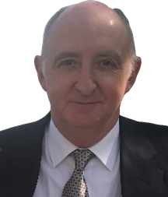
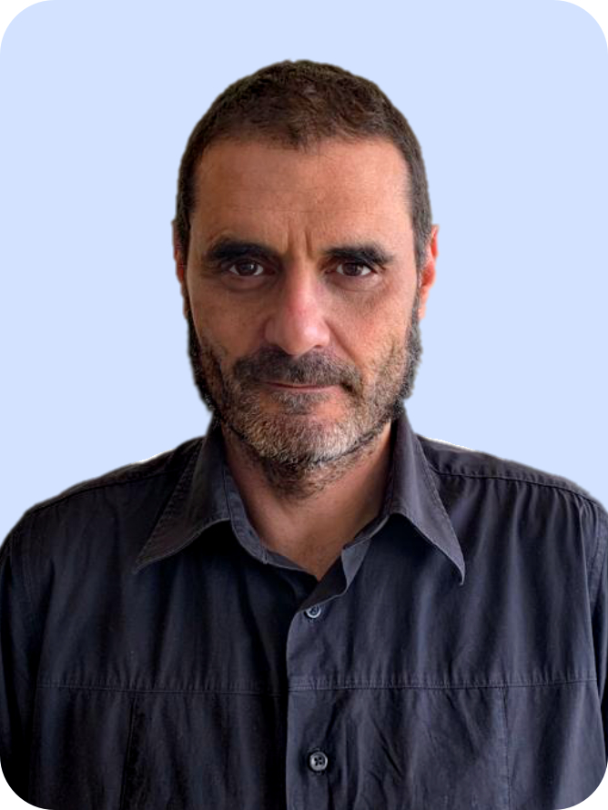
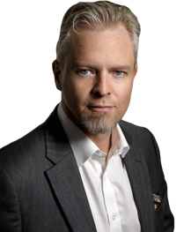
THE FOUNDERS
Esteban Ribot
Founder and CEO
linkedin.com/in/esteban-ribot-39472
Ismael Iglesias
Guy A. Reid
Founder and
CPO/CTO
Founder and VP Strategic Relationships
linkedin.com/in/ismaeltx
linkedin.com/in/guyalexanderreid

Slide 16
ASK & EXIT
j
STRUCTURE
ASK
The plan, to be agreed with the investor, is to migrate Symplum Technologies Holdings LLC (Delaware) to a C. Corp and to fund each new country's subsidiary as we plan to do with the Spanish entity to start the business.
We request a minimum Equity investment of
€500k (€250k * 2)
We believe the rest of the cash needs, as shown on page #14, can be filled with 24 months of debt, including about €250-500k in government aid, but we are open to discussing any financing plan that will allow us to achieve positive cash flow by the 12th month.
WHY NOW
In 2023 everybody expects to use digitally enabled claims and repairs, but the current insurance ecosystem, whether providing a service or reimbursement, can´t provide it.
For how many more years do we need to wait? The same happened when calling a cab or looking for holiday apartments, yet we have them.
Amongst other digital assets we have our must see POC at an advanced stage
EXITS
Dividends will be paid on profits after the 3rd year
The management believes there is an opportunity to be acquired or a strategic merger with a potential public offering to maximize shareholder value.

Slide 17
Thank You
for your time
Esteban Ribot
esteban.ribot@symplum.com
+34 616 647 790 (WhatsApp)
https://calendly.com/esteban-ribot-reuniones
symplum.com

