Slide 1
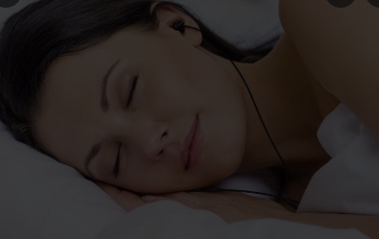
SnoryTime
Audiobooks that Put People to Sleep
eCom Consumer Tech Company

Slide 2
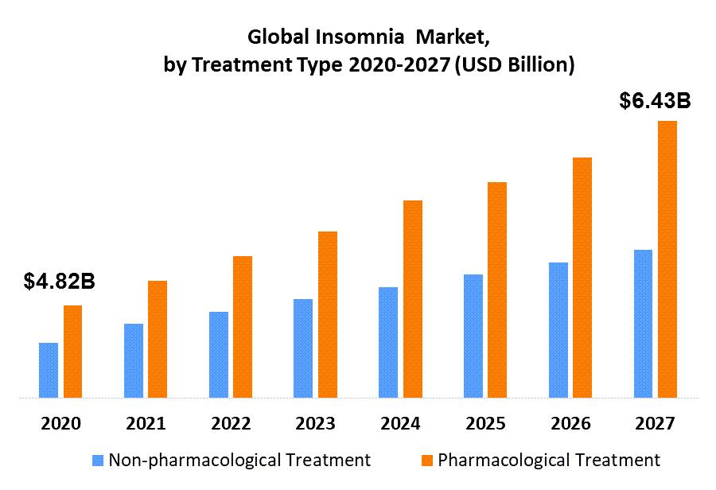
Insomnia Market will be worth $6.4 Billion by 2027
1 in 4 Americans develops Insomnia yearly.
With lockdowns and inflation, adults, teens, and kids are stressed/scared and can’t sleep.
Insomnia is a huge problem and will keep getting worse.
The Global Insomnia market was valued at $4.8B in 2020, and will be $6.4B by 2027.

Slide 3
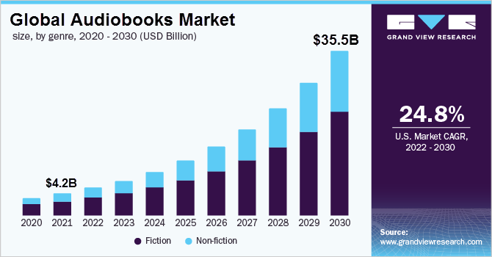
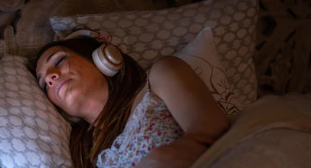
Audiobooks Market will be Worth $35B by 2030
Tens of millions love hearing audiobooks and the demand is rapidly increasing. Since 2020, publishers report audiobook sales are skyrocketing.
“increasing numbers of people are using audiobooks as part of their bedtime routine” - Penguin

Slide 4
The PROBLEM We Solve
Millions of adults listen to Audiobooks to help them fall asleep.
To effectively distract them from their worries, they need NEW content every night.
Users of existing solutions complain there aren’t enough relaxing, sleep-inducing audiobooks.
=> OUR members get a MASSIVE library of audiobooks for sleep.

Slide 5
How We Do It Better (and MUCH Cheaper!)
SnoryTime will have a MASSIVE library within just 6 short months!
We’ll record our own content at LIGHTNING SPEED by using break-through Neural AI Voices that sound just like a real human. CUTTING-EDGE Stealth Tech!
ALL OUR COMPETITORS are doing it the COSTLY old way: Creating 10,000 hours of recordings, will cost them $30,000,000+ and takes years.
We require only $60K per 10,000 hours of content and can produce it within 1 week.

Slide 6
Our USP
SnoryTime is “Audiobooks for Sleep”.
Read by gentle, hypnotic, sleep-inducing AI Human Replica Voices.
ALL our content is safe & relaxing for bedtime - without any loud sounds or bad surprises that wakes people or induces nightmares.
It’s the first & only HUGE audio library EXCLUSIVELY for sleep time.

Slide 7
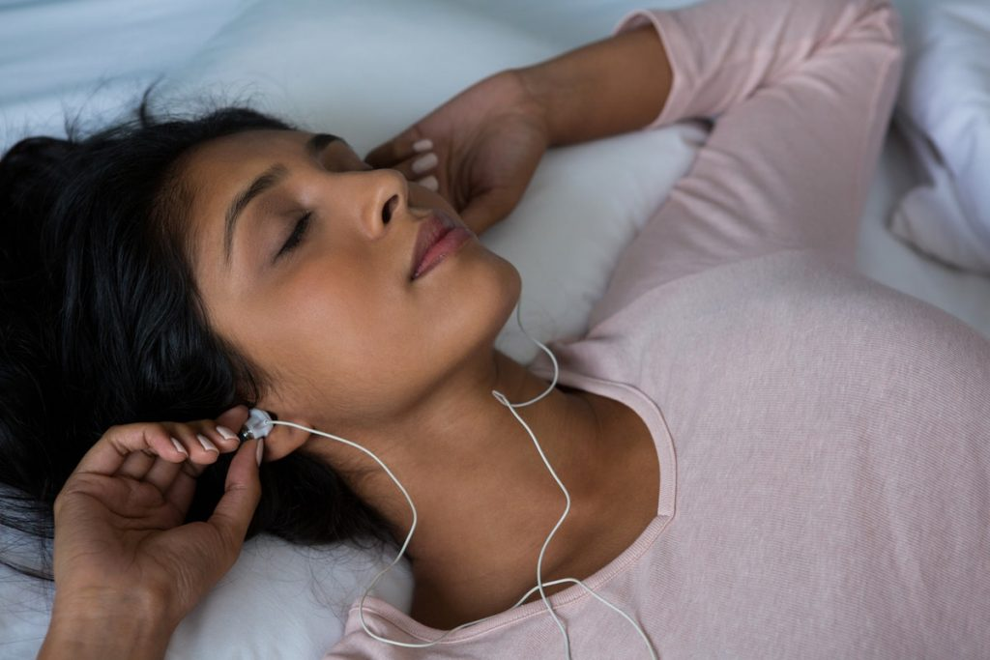
Many Languages = Global Domination!
We’ll QUICKLY Take Over the Global Market.
Our AI will automatically TRANSLATE audiobooks into many LANGUAGES, as we expand GLOBALLY.
NO need to hire huge teams of translators. Our AI voices will speak fluent English, German, Spanish, French, Japanese etc… It’s FAST & SUPER CHEAP!
Notes:
This is the solution. You want to explain what you do very clearly, in as few words as possible. Describe the concrete benefits you provide

Slide 8
Audio Success Examples
Unlike all these companies that needed YEARS and hundreds of millions in funding… SnoryTime is incredibly FAST to market and to PROFITABILITY by using 4-IR AI Tech.
We don’t really have competitors. General audiobook success examples:
Calm - Sleep stories for adults, with relaxing nature sounds & nature pics. Limited content. Valuation: $2.2 Billion. 100M+ installs. 4M paying subscribers @ $70/y.
Moshi - In 2020, they had 150 short sleep stories for kids. 140,000 subscribers @ $40/year.
Audible - Their revenue skyrocketed 3,948% from 2020 to 2022. Content mostly for daytime.
StoryTel - Audible competitor. 1.8M users & $213M revenue in 2021. Content for daytime listening.
Notes:
This is the solution. You want to explain what you do very clearly, in as few words as possible. Describe the concrete benefits you provide

Slide 9
From Seed to MARKET in 6 Months…
NO need to hire voice actors, studios, editors and spend weeks recording each audiobook!
NO need to work with authors or publishers to license their books.
NO need to create all the content ourselves.
NO need to spend years and hundreds of millions of dollars to build up our library.
1M+ ready-to-use content & books. We’ll have tens of thousands of audiobooks for kids and adults by using existing Public Domain books & Wiki articles that we can legally use commercially.
Original content. I’m a prolific storyteller and writer. It’s my biggest passion. Stories and ideas come to me like magic. Since I could talk, I’ve been telling stories that enchanted kids and adults. I’ve written hundreds of stories that we’ll turn into audiobooks – and I’ll happily write many more!
Reliable AI Readers who work 24/7 and produce a ready-to-sell 1h audiobook in a few SECONDS. No edits needed. No revisions required. No huge teams required. Just a few clicks per audiobook.
Notes:
This is the solution. You want to explain what you do very clearly, in as few words as possible. Describe the concrete benefits you provide

Slide 10
SEED Funding Needs - Raising $1.4M
Funding is needed for 6 months: Hiring a small team, gathering & creating content, for the AI voices, developing the subscription-based website and app, and acquiring our first users.
MONTH 1: Set up. Hiring a small team and developing the eCommerce subscription website.
MONTH 2: Content. We gather content as well as write our original content. Ongoing in next months.
MONTH 3: AI Readers. Voice actors are scouted, hired, and turned into our custom AI voices.
MONTH 4: Audiobook Creation. We produce ~10,000h of audiobooks “Snories” with the AI voices.
MONTH 5&6: Obtain initial paid users. We run a small marketing campaign and launch an affiliate program to acquire our first 15,000 PAID users to be self-sustainable. We add more content ongoing.
NEXT Phase: We raise growth funding for marketing/advertising campaigns to grow users, buy App installs, and further grow by translating our content library & website into ES, DE, IT, FR and more.
Notes:
This is the solution. You want to explain what you do very clearly, in as few words as possible. Describe the concrete benefits you provide

Slide 11
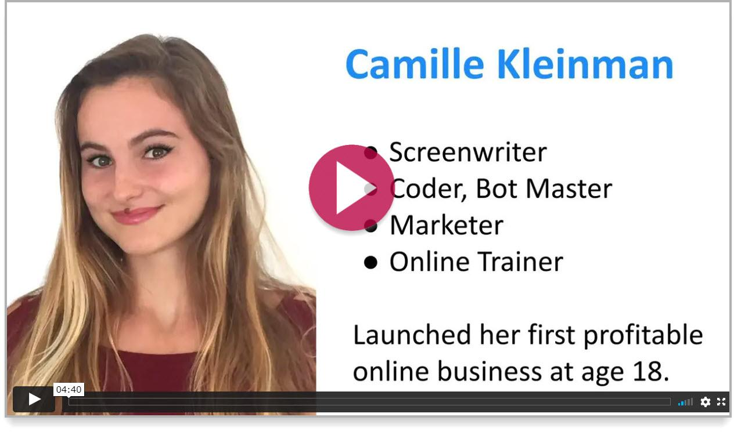
Hey, I’m Camille - Nice to meet You!
Contact me:
Camille Kleinman CK@CamilleKleinman.com
+1 954-271-2769
@hiCamilli
Watch this video to learn about me >>

