Slide 1
Fantasy Football League Software
Powered by Wolf Sports
David Chappine
davidchappine@wolfsports.com

Slide 2
Problem
Fantasy sports is a massive industry, with a projected CAGR of 14.50% from 2023-2032 and projected market size of $84.9 billion in 2032.
However, fantasy coverage, leagues, and tools are uninventive and outdated in 2023.
Season-long fantasy football leagues (hosting platforms) do not match the standards of technology and customization in today’s world.
Users are forced to select their preferred least bad option to host a traditional fantasy league and connect with friends, family, and colleagues.

Slide 3
Solution
So, we plan to build the best fantasy football league-hosting platform in the world.
The focus will be on customization within an easy-to-use platform on both desktop and mobile.
Things like a fully-capable mobile app (allowing you to do everything you can do on desktop), extremely detailed league history, expansion and dynasty options, draft settings, and more would be fully customizable.
Leverage AI and potentially smart technology like Amazon Alexa to help with start-sit decisions, tracking players, and viewing scores.

Slide 4
Business Model
Major Traffic
Fantasy football leagues create more log-in events than almost anything in any industry (Axios impact report here)
Depth
Full customization for users to track their teams and scores how they want, along with the ability to customize the league settings however they want
“Freemium”
Add-on content individual users can purchase to access extra logos, features, etc. (also an online store to purchase championship belts, gear, etc.)
Early Exit/Licensing
Target acquisition by NFL Media, other titanic media companies
*

Slide 5
Competition
ESPN, NFL.com, Yahoo, and CBS all have platforms that feel like they were built for users in the previous decade—not looking ahead to the future.
Sleeper is a start-up platform, but the interface is cluttered and daunting even for experienced players like us.
ESPN is the most popular.
Strengths: Easy-to-use mobile app and many people are familiar with playing on ESPN.
Weaknesses: limited features, poor customization, no dynasty leagues, ads on FantasyCast are very intrusive, subpar analysis, no offline draft app (they took it away without telling users), toyed with users about in-depth league history and deleted it permanently.

Slide 6
Marketing Plan
Users are not happy with their options: People will join if we build an exceptional fantasy football platform.
The super-powerful “viral growth” strategy will happen organically as people invite their friends to leagues.
Social Media Ads, Google Ads to target the right people.
We must build a platform so strong—from features to function to appearance—that people will give it a chance.
We can tap into users’ frustration with ESPN Fantasy Football.
People were outraged over ESPN taking away the Offline Draft App in 2018, and many were also unhappy about the deletion of in-depth league history in 2019.

Slide 7
Management Team
David and Dylan Chappine.
We are 28-year-old twin brothers from Hammonton, New Jersey, United States.
We graduated from Stockton University in 2017.
We have the most accurate NFL Draft coverage in media, with a hit rate over 40 percent better than NFL teams.
Despite zero marketing spend, we have 10,000+ users/emails in the fantasy football niche.
Our premium members have won six figure prizes utilizing our analysis.

Slide 8
Our Credibility
This review was offered up by former FanSided founder and CEO Adam Best, a subscriber to Wolf Sports’ Fantasy Consigliere. Hopefully it speaks to our expertise in this field.
“I've long been an avid and fairly successful fantasy football player, but Fantasy Consigliere took my game to another level over the past two seasons and helped me break out of a multi-year slump. This season I finished first in two leagues during the regular season, won one championship, and put together what looks like a successful dynasty rebuild in my third league. I'm a bit of a gunslinger, so the Consigliere is perfect for guiding me away from costly sit/start, trade, and waiver mistakes while still pushing me to be more aggressive than all of my competitors. Gutsy decisions they consulted on -- ones which often bucked consensus rankings from other experts -- helped me win crucial games I would've otherwise lost, including a championship game where I was a huge underdog. Highly recommend this service and wish I would've thought of it first!” – Adam Best, former CEO, FanSided

Slide 9
Traditional Fantasy Football
In the entire Walt Disney Company, ESPN Fantasy Football creates more log-in events than anything.
Traditional fantasy football league log-ins (most users check multiple times per day every day during the season) can help send people to sportsbooks.
Much of the focus is on daily fantasy sports and sportsbooks, so there is an opening for traditional season-long fantasy football leagues to make an impact in the sports betting market.

Slide 10
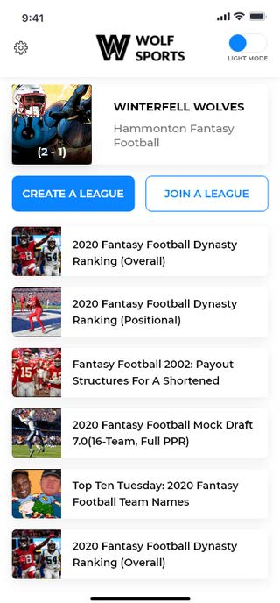
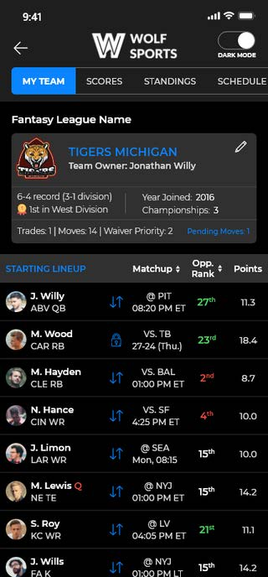
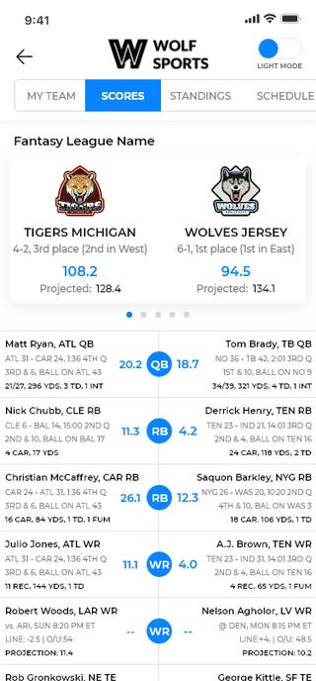
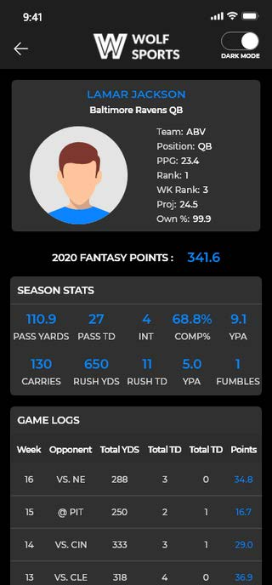
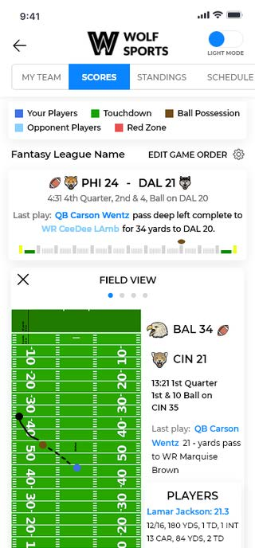
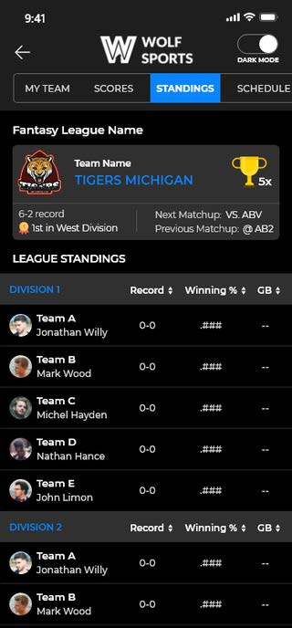
Rough Prototype App *NOT FINAL*
We created a very rough prototype app giving a look at how the platform would work on mobile.
In-depth league history and the full customization options are not displayed in the prototype.

Slide 11
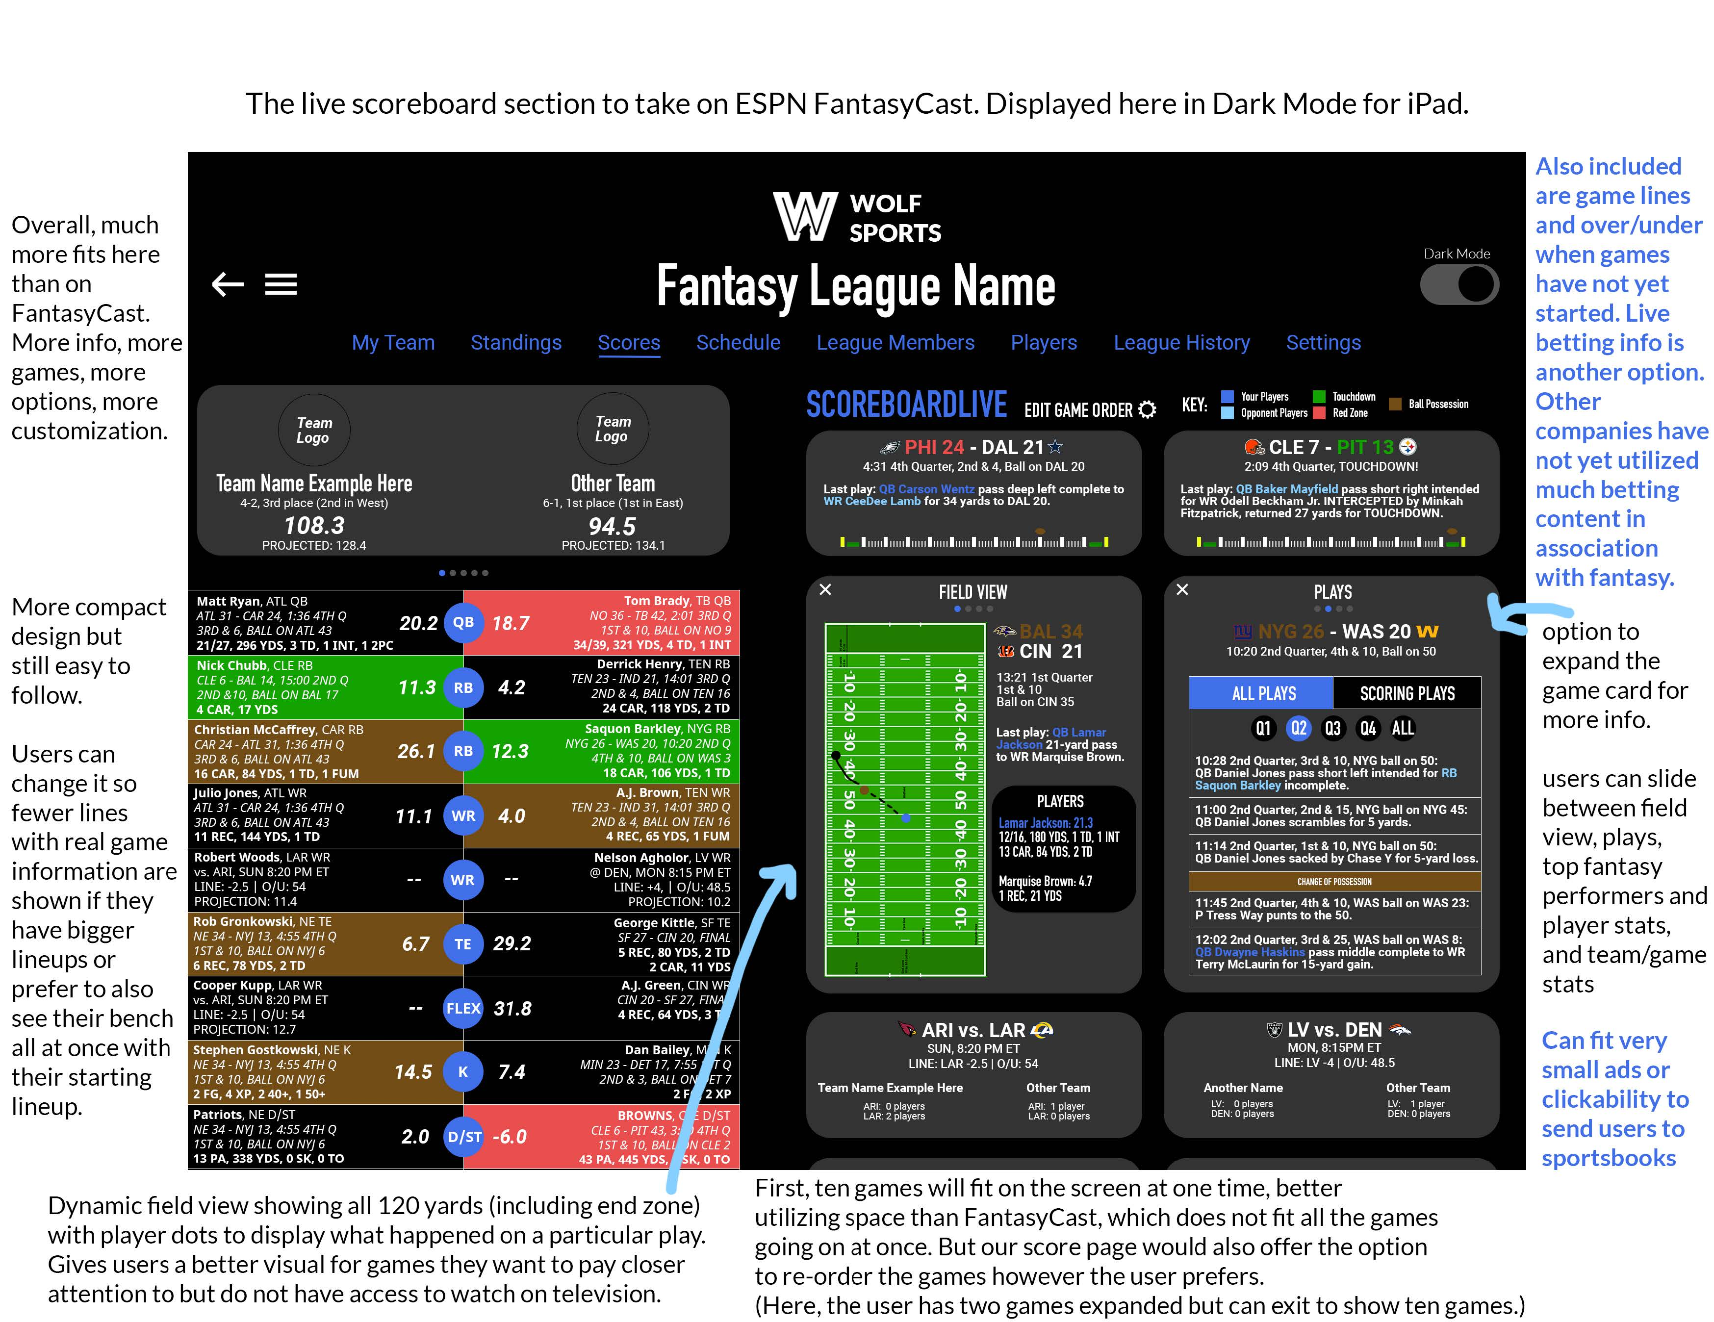
ScoreboardLive
Our competitor to ESPN’s FantasyCast.
Incorporate betting information: O/U, game lines, etc.
Unlike FantasyCast, ScoreboardLive will be fully customizable, allowing users to re-order and see the games and content most important to them.

Slide 12
Offline Drafts
Many fantasy football players love getting together and drafting with their friends in person.
For us, it is one of our favorite days of the year.
One of the top features ESPN used to offer was an offline draft application that allowed you to display the live draft board on a big screen.
ESPN took it away without telling users, leading to some outrage.
We will bring this key feature to our new platform.

Slide 13
Software
The plan is to present and license the fantasy football league hosting platform as software.
Titanic media companies are buying up assets in the sports betting race.
FOX Sports, Amazon—both currently with no fantasy content—and NBC Sports are three big prospective targets, as are the sports betting companies.
NFL Media could also be interested given how poor their current platform is.
We can either take a royalty rate or a fixed fee to license the software.

Slide 14
The Ask
We are looking to raise $2 million in seed funding at 30% equity to build a brand-new customizable and user-friendly fantasy football platform.
We can self-fund $100K.
We will use the funds for:
Building and maintaining the hosting platform over three years ($1.75 million)
Marketing and customer acquisition ($200K)
API for live stats and scoring ($50K)
(Sportradar had expressed some interest in a partnership where they get equity in exchange for data use)

Slide 15
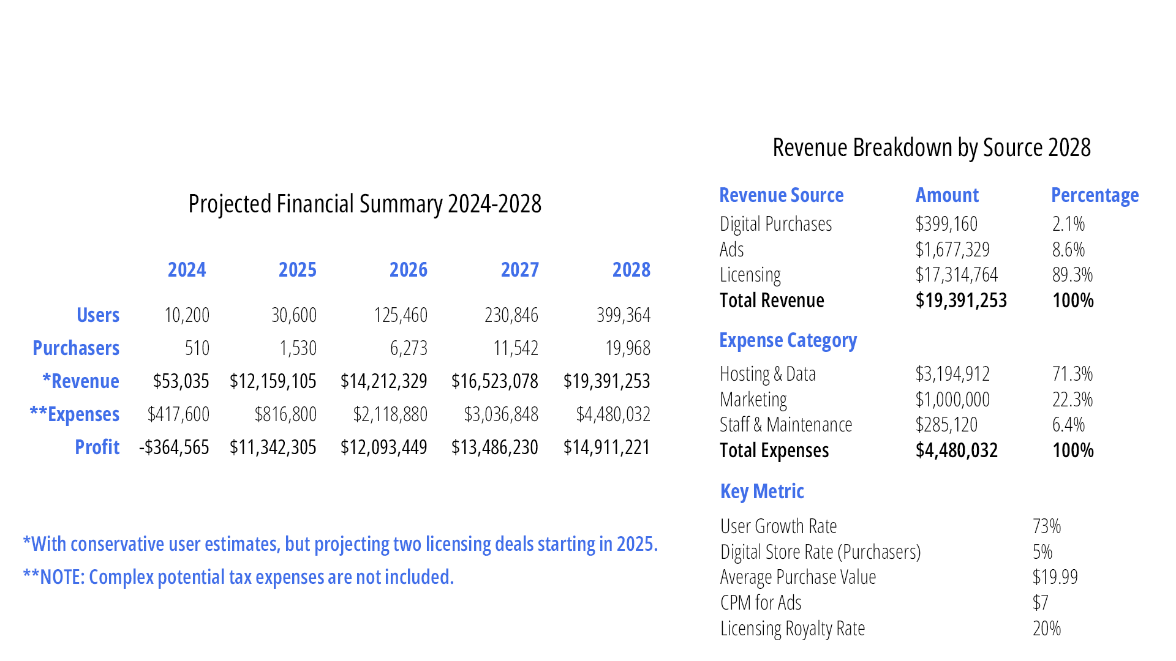
Financial Projections

